Slide 1
CREDIT EDA CASE STUDY SREEDEVI GATTU & DISHANT PATEL August 2021

Slide 2
CONTENTS
PROBLEM STATEMENT
DATA
STRATEGY/METHODOLOGY FOR ANALYSIS
DATA – IMBALANCE, HANDLING FOR MISSING/INVALID VALUES, OUTLIERS
ANALYSIS
Demographic – Personal
Demographic - Professional
Character
Capacity
Capital
Application
CORRELATION OF VARIABLES
RECOMMENDATIONS

Slide 3
PROBLEM STATEMENT
What is the THE PROBLEM we trying to address?
A consumer finance company specialises in lending various types of loans to urban customers. As there is insufficient or no credit history, the company does not know whether a customer is reliable or not. Some consumers use it to their advantage by becoming a defaulter.
When the company receives a loan application, it must decide for loan approval based on the applicant’s profile.
Two types of risks are associated with the bank’s decision. If the applicant is
likely to repay the loan, then not approving the loan results in a loss of business to the company
not likely to repay the loan, then approving the loan results in a financial loss to the company
What is REQUIRED as part of EDA?
Identify patterns present in the data which indicate if a client has difficulty paying their instalments. Identify the driving factors/variables behind loan default which are strong indicators of default.
How does this analysis HELP the company?
The company can utilise this knowledge for its portfolio and risk assessment. This will help the company
To take actions (such as denying the loan, reducing the amount of loan etc.) against risky applicants
Not to reject applicants capable of repaying the loan

Slide 4
DATA
Two datasets were provided
Current Application dataset contains information about the current loan application of the clients. For each client, there is
Personal, professional, assets owned, loan application, load & goods amount information: 121 columns
TARGET variable to indicate whether the clients had
Payment difficulties TARGET=1
No payment difficulties TARGET=0
Previous Application dataset contains information about the previous loan applications of clients.
There could be multiple previous applications/entries for a client
Each application has information of the status - Approved, Rejected, Cancelled & Unused offer
In both the datasets, unique identifier SK_ID_CURR identifies a client.
Since the number of columns is very high, the columns will be grouped into multiple categories (see next slide)

Slide 5
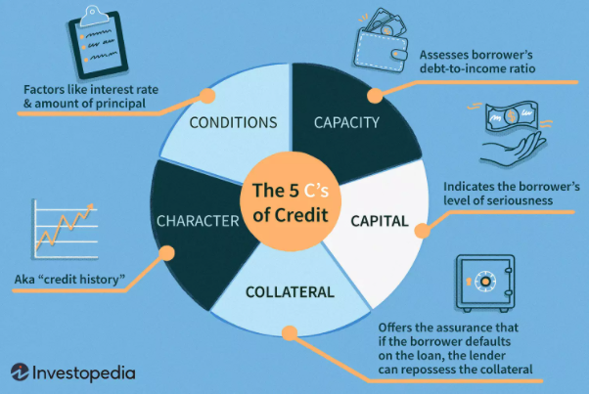
ANALYSIS STRATEGY
The variables/columns are categorised into following categories
For each of the categories, following is carried out
Inspect dataset for data imbalance, missing & invalid values
Analysis - Univariate, Bivariate
Draw Observations/Insights
Correlation analysis is done on all the variables
Category | Variables from the dataset
Demographic - Personal | Personal details like Gender, Age, Number of Children etc.
Demographic - Professional | Details related to profession like education, Income, Organization etc.
Character | Previous Credit history, Number of calls to credit bureau
Capacity | Debt to income ratio, Income, Goods, Credit amounts,
Capital | Whether the applicant owns car, realty
Application | Information like contact details, documents provided
Character, Capacity, Capital categories are inspired from the Five C's of Credit system that is used by lenders to gauge the creditworthiness of potential borrowers

Slide 6
DATA - IMBALANCE
In the current application dataset, data corresponding to the clients with TARGET=1 is much lesser (8%) than compared to the data with TARGET=0 (92%).
There is a data imbalance with respect to the TARGET variable in the ratio 92% (0) and 8% (1). This means the data corresponding to the clients with payment difficulties is very less compared to the clients without payment difficulties.
Handling To avoid this imbalance, bias the analysis (towards the Target=0 case), the comparisons of various variables with respect to the Target categories (0 & 1) were made using percentages
Note: No duplicate rows were found in the dataset
TARGET | Entries - Count | Entries - %
0 | 2,82,686 | 91.93%
1 | 24,825 | 8.07%
 | 307511 | 100%

Slide 7
DATA - MISSING/INVALID
Type of missing/invalid data | Handling | Instances
Columns with data is missing > 50% | Drop the columns | BUILDING related data, OCCUPATION_TYPE etc.
Columns not relevant for analysis | Drop the columns | EXT_SOURCE_*
Columns with similar data | Retain only one & drop the rest | REGION_RATING_CLIENT & REGION_RATING_CLIENT_W_CITY
Columns with similar data | Aggregate (add multiple columns) into a single column & drop the rest | FLAG_DOCUMENT_* FLAG_MOBIL, FLAG_*_PHONE, FLAG_EMAIL OBS_CNT_SOCIAL_CIRCLE DEF_CNT_SOCIAL_CIRCLE AMT_REQ_CREDIT_BUREAU_* → ENQUIRIES_CREDIT_BUREAU
Columns with related information | Derive from other columns | AMT_GOODS_PRICE = 90 % of AMT_CREDIT AMT_ANNUITY = 5% of AMT_CREDIT
Columns with missing data < 50% | Impute with median value | CNT_FAM_MEMBERS, AMT_REQ_CREDIT_BUREAU_* , OBS_CNT_SOCIAL_CIRCLE, DEF_CNT_SOCIAL_CIRCLE
Rows with missing/invalid data < 1% | Drop the rows | CODE_GENDER, NAME_FAMILY_STATUS

Slide 8
DATA - TRANSFORM
Wherever relevant, multiple columns were transformed into more meaningful formats
Type of data | Transformation | Examples
Days relative to the time of application (-ve values) | Converted to years (+ve value) | DAYS_BIRTH → AGE DAYS_REGISTRATION → YEARS_REGISTRATION DAYS_ID_PUBLISH → YEARS_ID_PUBLISH
Categories in numerical format | Converted to categorical values (string) | REGION_RATING_CLIENT*
New columns | Aggregated multiple columns to percentage | DEF_PC_SOCIAL_CIRCLE = DEF_CNT_SOCIAL_CIRCLE /OBS_CNT_SOCIAL_CIRCLE DEBT_TO_INCOME = AMT_ANNUITY/_INCOME_TOTAL

Slide 9
DATA - OUTLIERS
The following outliers were identified by using boxplots
Variable | Outliers
CNT_CHILDREN | > 2.5 till 19
CNT_FAM_MEMBERS | > 5 till 20
REGION_POPULATION_RELATIVE | 1 area is heavily populated compared to the rest
AMT_REQ_CREDIT_BUREAU_* | Extremely high value of 262
AMT_INCOME_TOTAL | Extremely high value of 117000000.0
YEARS_REGISTRATION | > 40 years
DEBT_TO_INCOME | > 50
AMT_CREDIT | > 1600000
AMT_ANNUITY | > 80000
AMT_GOODS_PRICE | > 1500000

Slide 10
DEMOGRAPHIC PERSONAL
Gender
Region Rating
Age
Male clients have difficulties in paying
Clients in region 3 have difficulties in paying
Younger clients have difficulties in paying

Slide 11
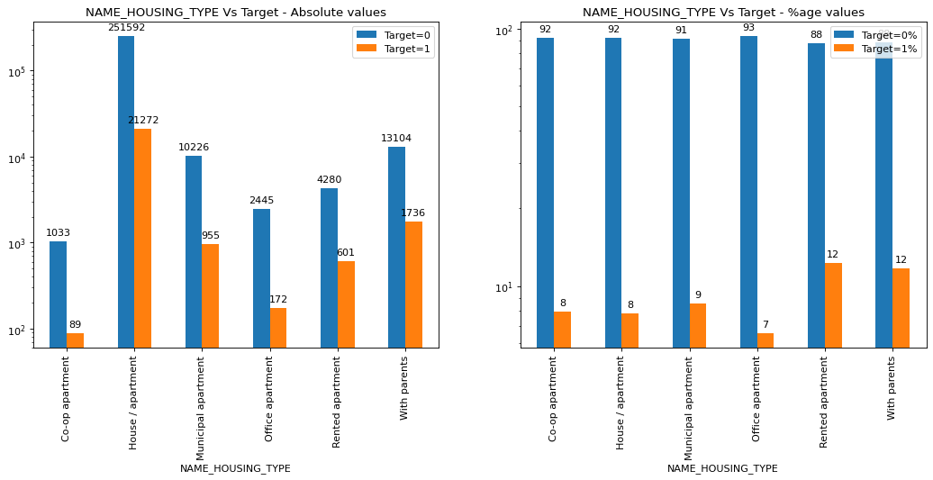
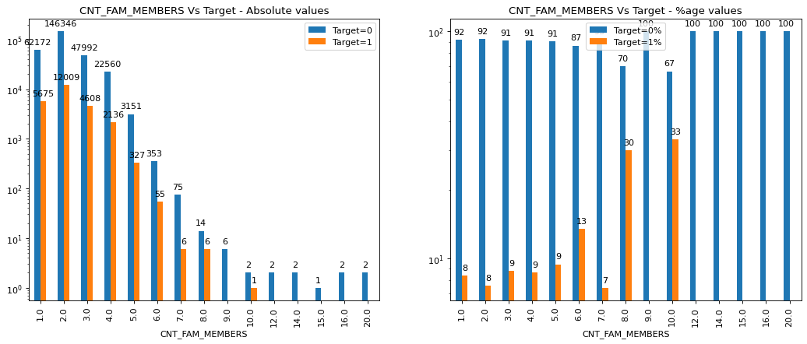
DEMOGRAPHIC PERSONAL
Housing
No. Children
Family Size
Clients living in Rented apartments or with parents have issues
As the number of children increases, issues of payment increases
As the family member count increases, issues of payment increases

Slide 12
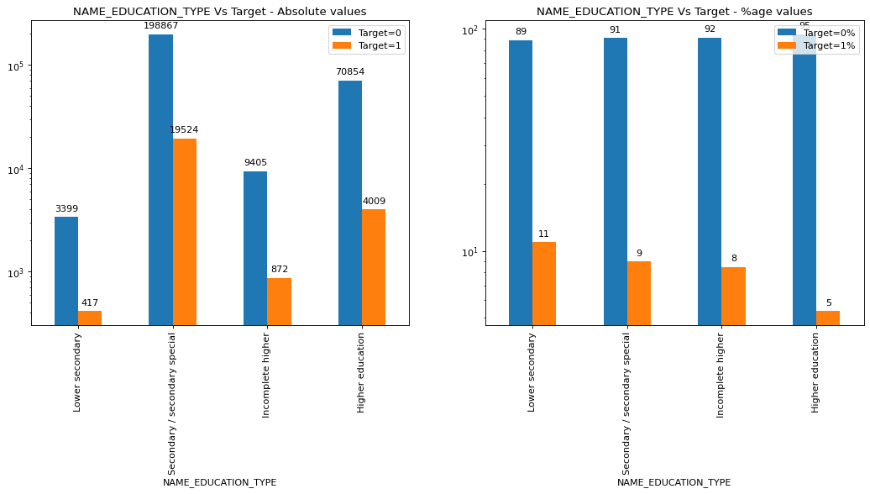
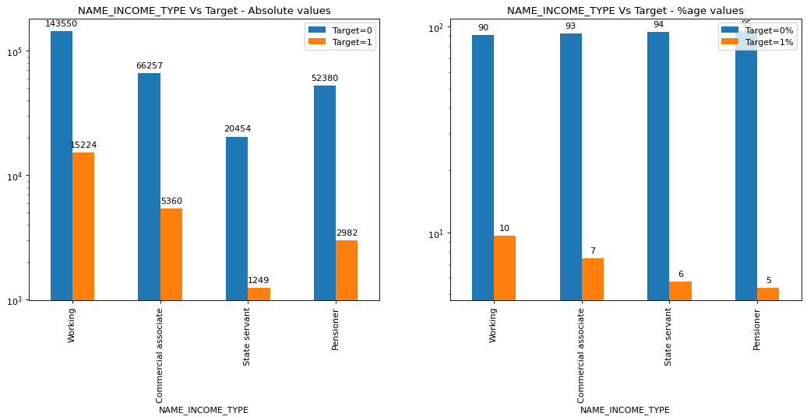
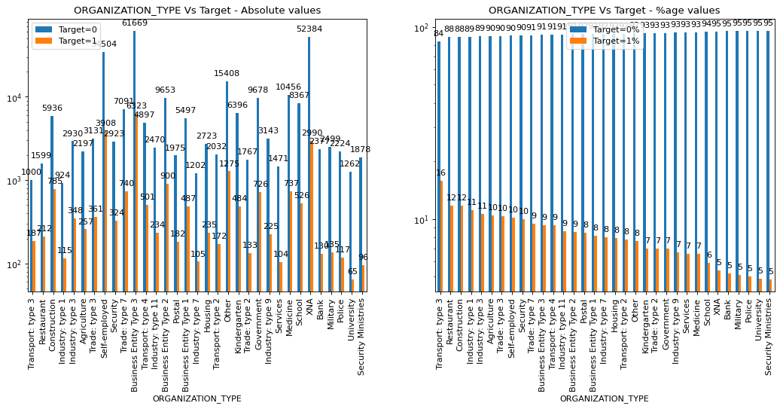
DEMOGRAPHIC PROFESSIONAL
Education
Income Type
Organization Type
Less educated clients have issues with payment
Working class clients have issues with payment
Transport Type 3, Restaurant have issues with payment

Slide 13
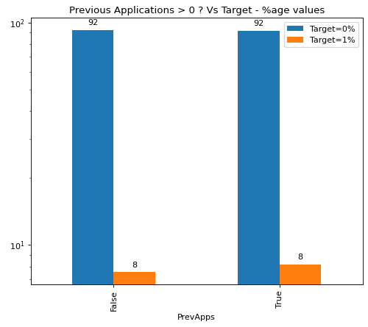
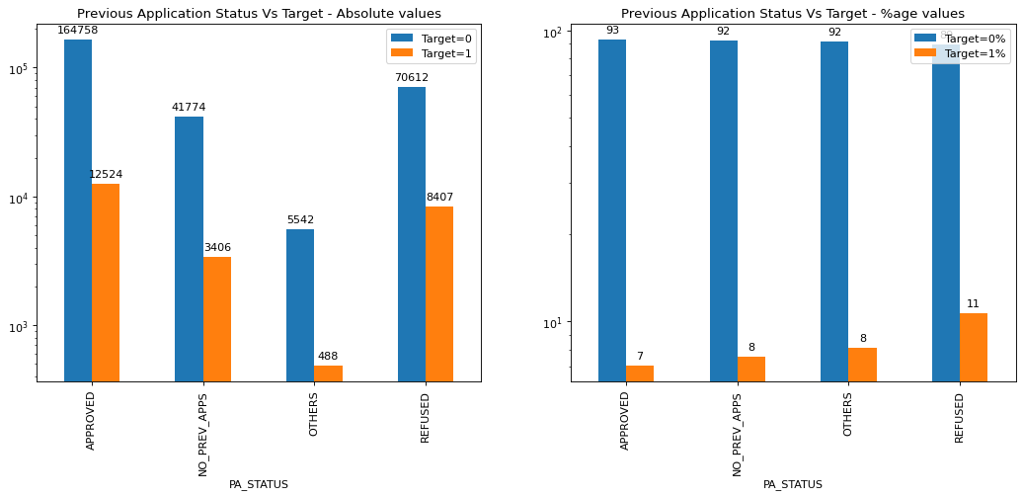
CHARACTER CREDIT HISTORY
No. Previous Applications
Previous Application Status
No difference
If earlier application was refused, then client faces difficulties

Slide 14
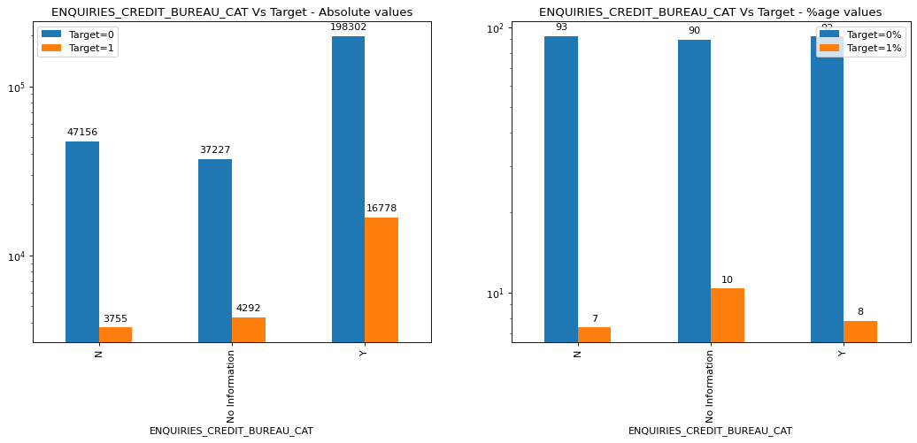
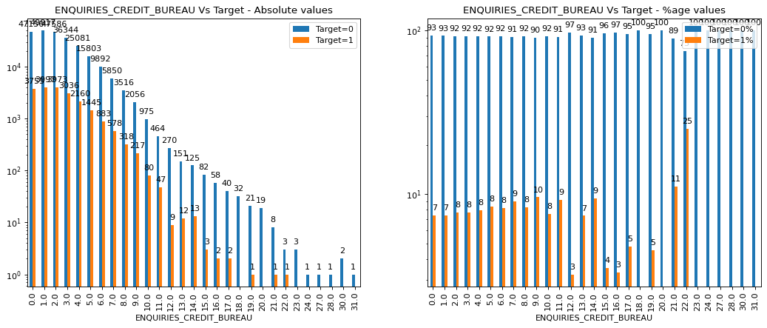
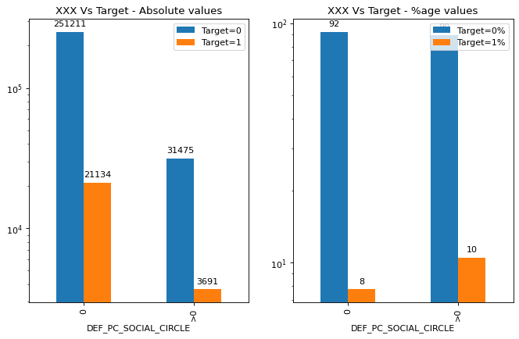
CHARACTER CREDIT HISTORY/ SOCIAL CIRCLE
Enquiries to Credit Bureau
No. Enquiries to Credit Bureau
Enquiries to Credit Bureau
No clear trend
No clear trend
Clients with defaulters in social circle faces issues

Slide 15
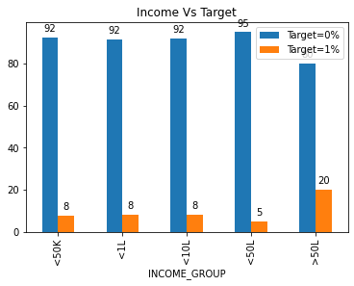
CAPACITY AMOUNT INCOME
Income
Income
Income>50 L faces issues
No clear trend

Slide 16
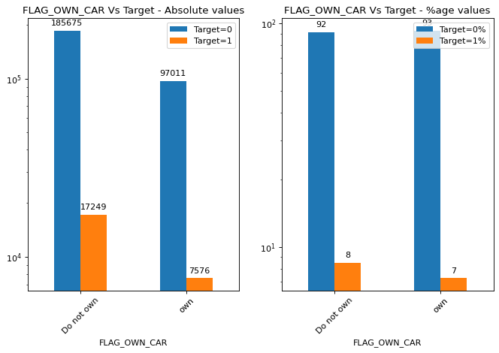
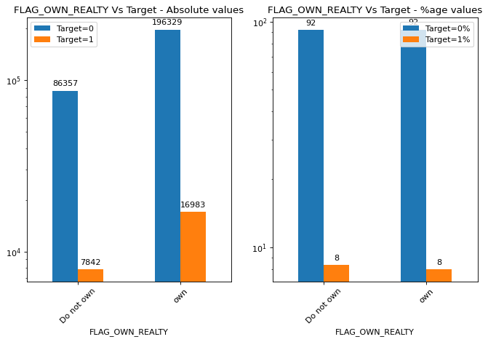
CAPITA OWN CAR/ REALITY
Own a Car?
Own Realty?
No clear trend
No clear trend

Slide 17
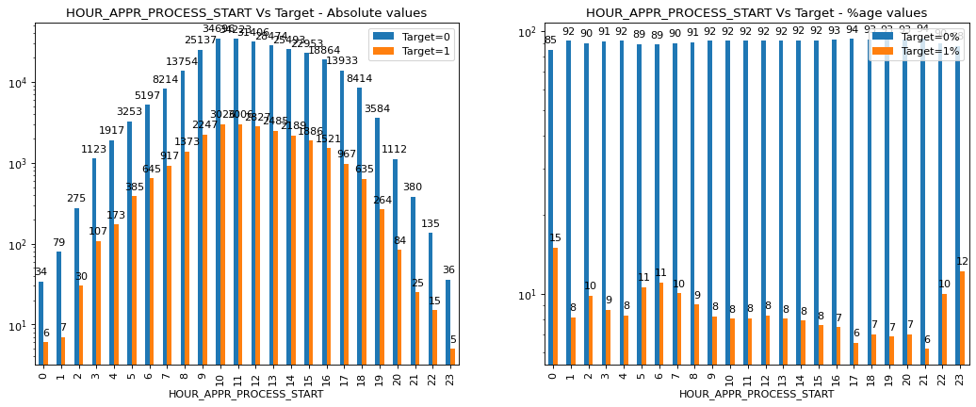
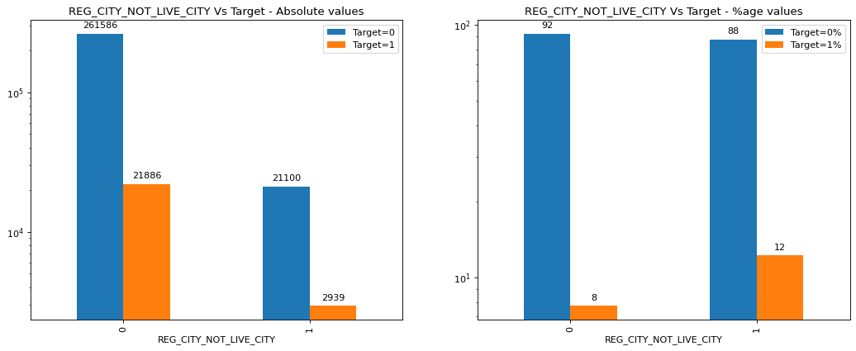
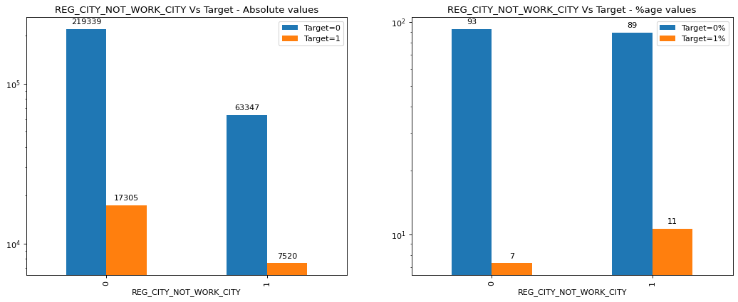
APPLICATION
This data set has multiple plots, hence only those plots which show some difference between Target 1 & 0 have been shown
Time when application is filled
Permanent, Present, Work Address – Same or not?
Application made in late night hours have issues
If client permanent address does not match present/work then issues are there – but not prominent

Slide 18
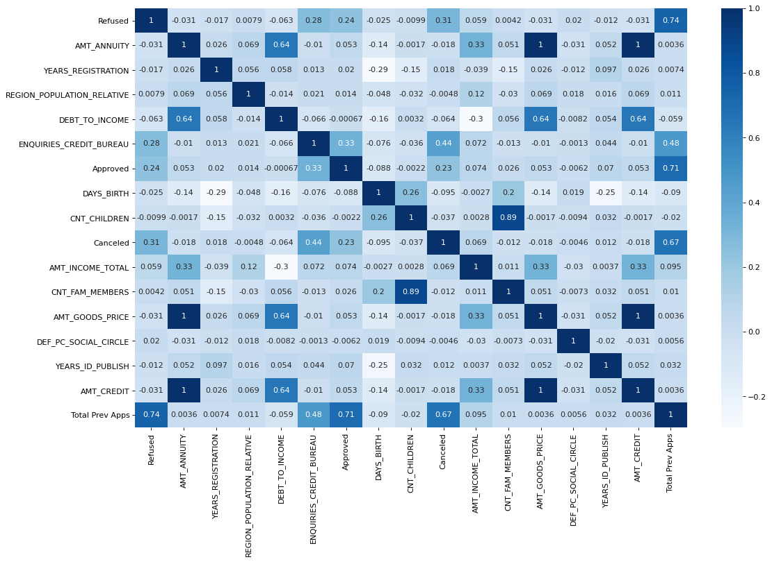
CORELATIONS Target =1

Slide 19
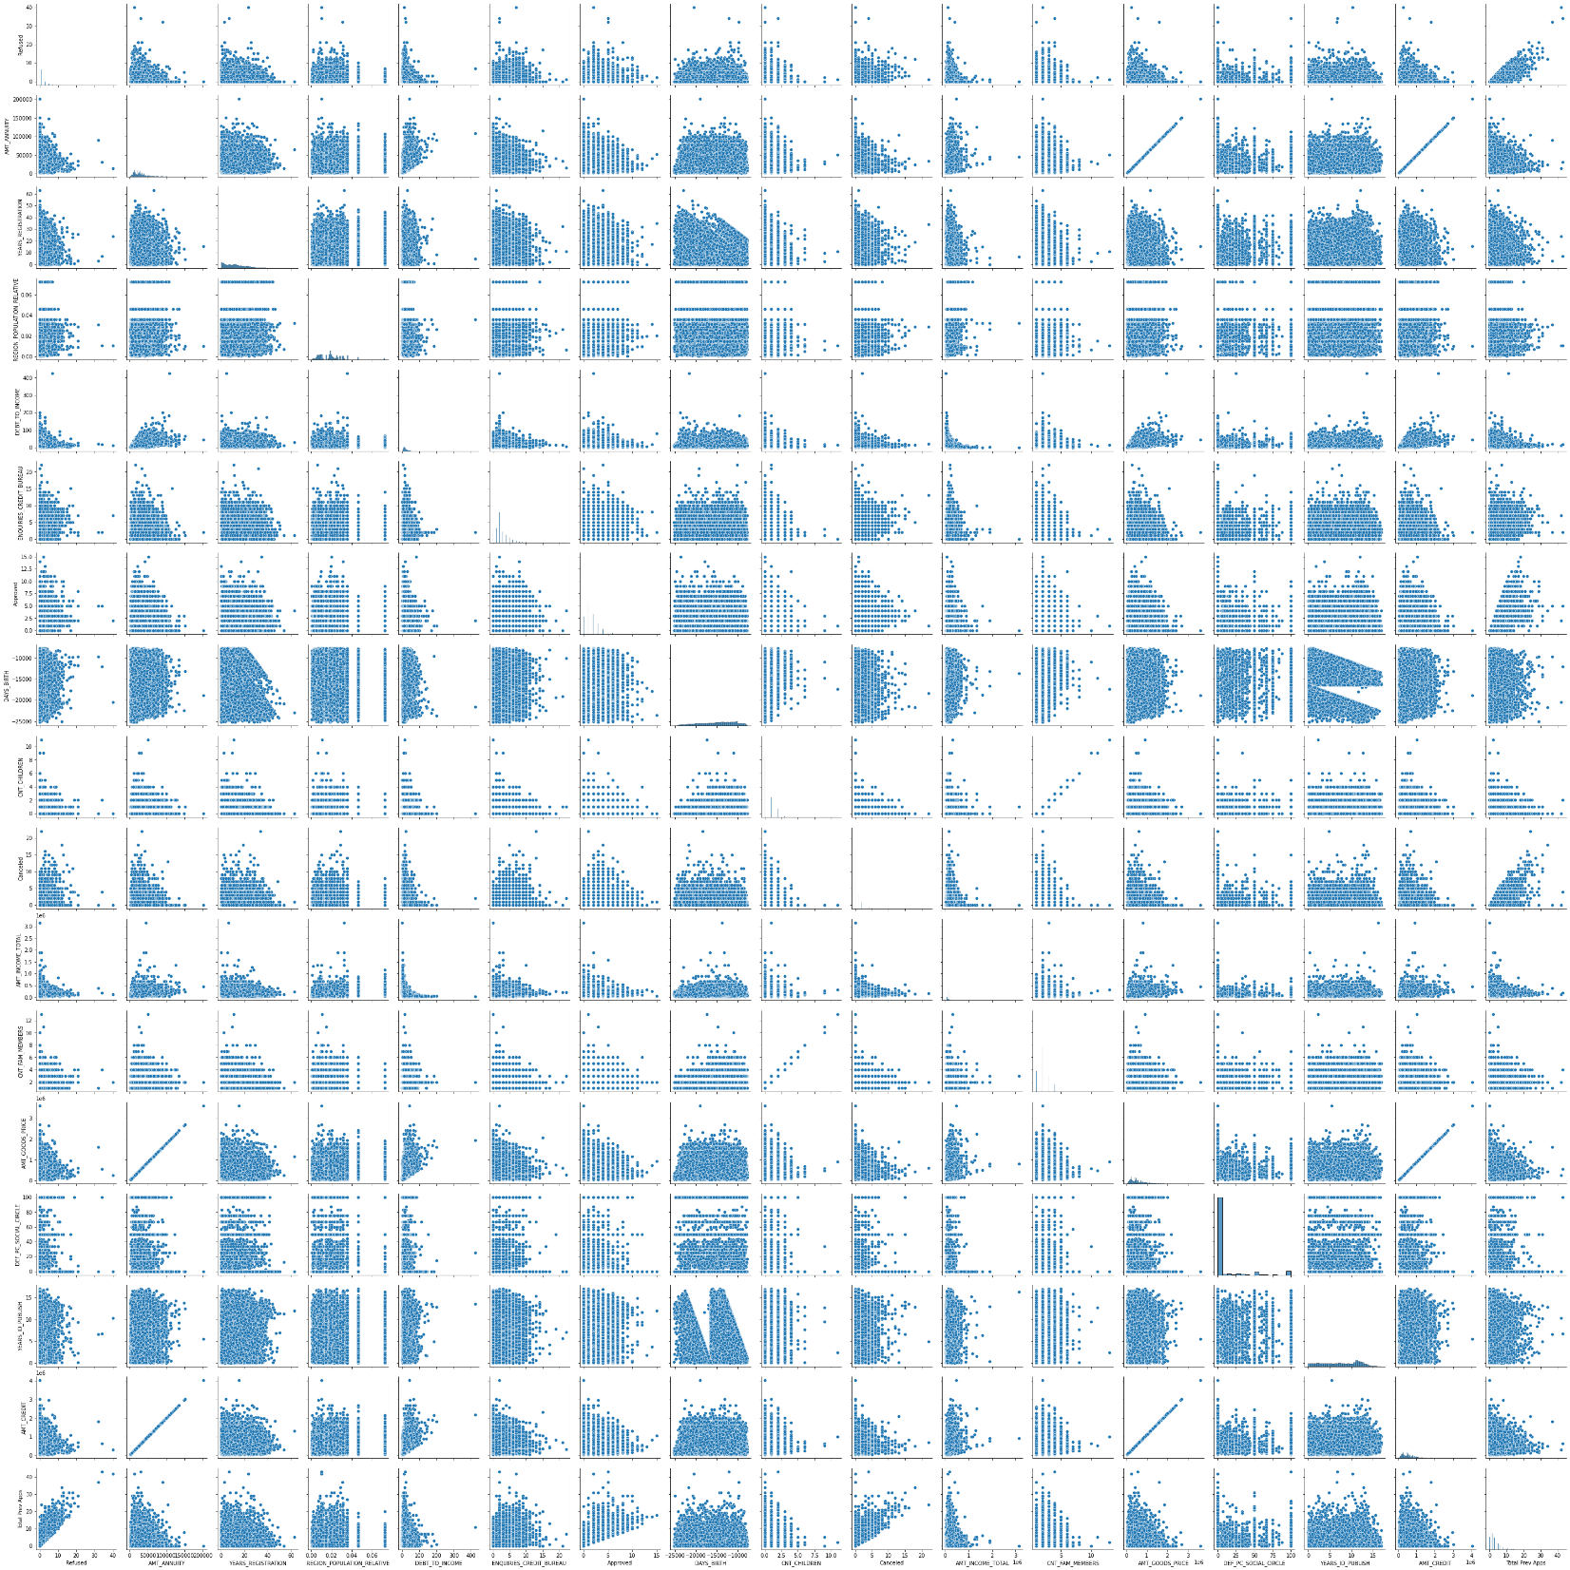
PAIR PLOTS Target = 1

Slide 20
CORELATIONS Target=0

Slide 21
PAIR PLOTS Target=0

Slide 22
TOP 10 CORELATIONS
TOP 10 CORRELATIONS for TARGET=1
AMT_CREDIT & AMT_GOODS_PRICE 1
AMT_CREDIT & AMT_ANNUITY 1
AMT_GOODS_PRICE & AMT_ANNUITY 1
CNT_CHILDREN & CNT_FAM_MEMBERS 0.89
Total Prev Apps & Refused 0.74
Approved & Total Prev Apps 0.71
Total Prev Apps & Cancelled 0.67
Debt to Income & Amt_Credit 0.64
Debt to Income & Amt_Goods_Price 0.64
AMT_ANNUITY & DEBT_TO_INCOME 0.64
TOP 10 CORRELATIONS for TARGET=0
AMT_CREDIT & AMT_GOODS_PRICE 1
AMT_CREDIT & AMT_ANNUITY 1
AMT_GOODS_PRICE & AMT_ANNUITY 1
CNT_CHILDREN & CNT_FAM_MEMBERS 0.88
Approved & Total Prev Apps 0.77
Refused & Total Prev Apps 0.68
Total Prev Apps & Cancelled 0.66
Debt to Income & Amt_Credit 0.65
Debt to Income & Amt_Goods_Price 0.65
AMT_ANNUITY & DEBT_TO_INCOME 0.65

Slide 23
RECOMMENDATIONS
DRIVING FACTOR | RISKY Difficulties in paying | SAFE No difficulties in paying
Gender | Male Clients | Female clients
Age | Younger Clients | Older clients
No. Children | More children | Less children
Family size | Larger family size | Smaller family size
Family Status | Civil Married, Single/Not Married | Widow
Housing | Clients in Rented apartment or staying at parents house | -
Region Rating | Higher Region category | Lower Region category
Education | Clients with lesser education | Clients with higher education
Income Type | Working | Pensioner, State Servant
Organization | Transport Type 3 | Bank
Previous Applications | With Prev Apps REFUSED | -
Defaulters in social circle | Clients with higher percentage of defaulters in social circle | Clients with lesser %age of defaulters in social circle
Income | Clients from the >50L income group seem to be having difficulties in paying the loan | -
If the profile of a new client falls in the
RISKY group, then caution should be exercised to extending a loan
SAFE group, then loan should be given

Slide 24
Thank you

Slide 25
OBSERVATIONS consolidated
DRIVING FACTOR | Description | Risky Difficulties in paying | Safe No difficulties in paying
Gender CODE_GENDER | More percentage of male clients have difficulties in paying | Male Clients | Female clients
Age DAYS_BIRTH --> AGE | Lesser age, more difficulty in paying | Younger Clients | Older clients
No. Children CNT_CHILDREN | With increase in number of kids, the ability to pay decreases. | More children | Less children
No. Family members CNT_FAM_MEMBERS | With increase in number of family members, the ability to pay decreases | Larger family size | Smaller family size
Family Status NAME_FAMILY_STATUS | No clear observation | Civil Married Single/Not Married | Widow
Housing HOUSING_TYPE |  | Clients in Rented apartment or staying at parents house
Region Rating REGION_RATING_CLIENT, REGION_RATING_CLIENT_W_CITY | Higher the region, the clients find it more difficult to pay. Clients from regions 3 have difficulty in paying off | Higher Region category | Lower Region category
CONTD…

Slide 26
OBSERVATIONS consolidated
CONTD…
DRIVING FACTOR | Description | Risky Difficulties in paying | Safe No difficulties in paying
Education NAME_EDUCATION_TYPE | With increase in education, the ability to pay increases. | Clients with lesser education | Clients with higher education
Income Type NAME_INCOME_TYPE | None | Working | Pensioner, State Servant
Organization ORGANIZATION_TYPE | None | Transport Type 3 | Bank
Previous Applications PREV_APPS | Having Prev Apps does not indicate any difficulty or otherwise | With Prev Apps refused
Defaulter in social circle SOCIAL_CIRCLEDEFAULT% | Clients with defaulters in social circle | Clients with higher percentage of defaulters in social circle | Clients with lesser %age of defaulters in social circle
Income INCOME | This does not affect the client's ability to pay | Clients from the >50L income group seem to be having difficulties in paying the loan | None
Debt-To-Income Ratio DEBT-TO-INCOME | This does not affect the client's ability to pay
Amounts AMT_CREDIT, AMT_ANNUITY, AMT_GOODS_PRICE | Independently these does not affect the client's ability to pay

